Slide 1

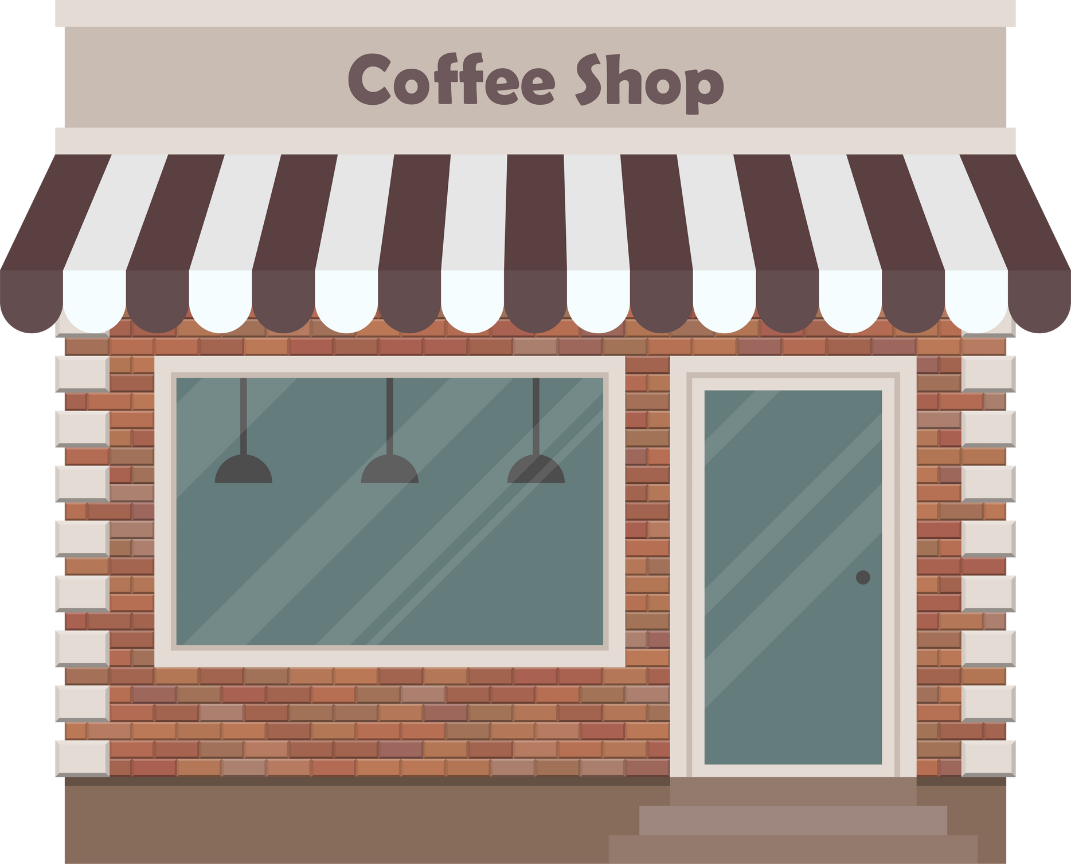





The objective of this project is to analyze coffee shop retail sales data to generate actionable insights that can support revenue growth, operational efficiency, and product strategy

Slide 2


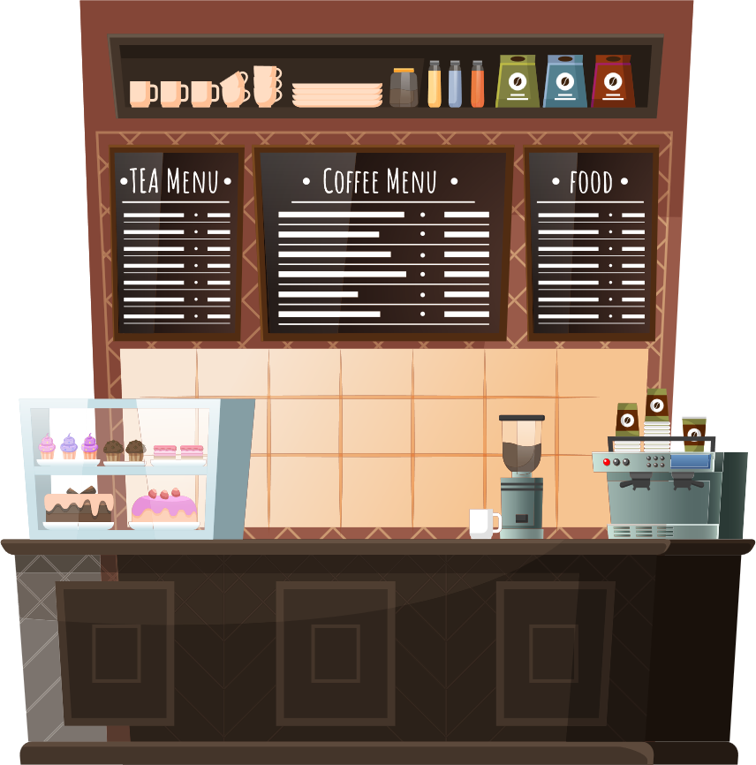



Things to Analyze
How do sales vary by day of the week and hour of the day?
Are there any peak times for sales activities?
What is the total sales revenue for each month?
How do sales vary across different store location?
What is the average price/order per person?
Which products are the best selling in terms of quantity and revenue?
How do sales vary by product category and type ?

Slide 3
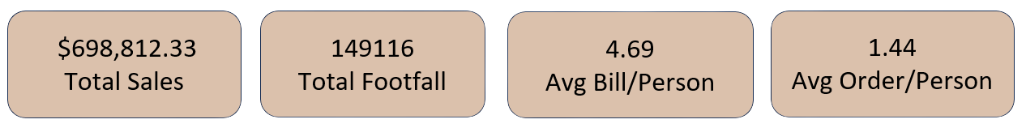
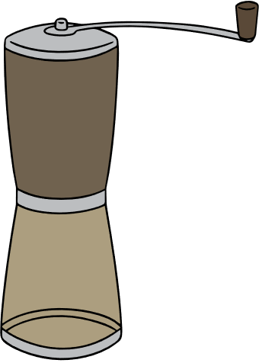





Key Business Metrics (KPIs)
The dashboard tracks the following core performance indicators:
Total Sales Revenue: $698,812.33
Total Footfall: 149,116 customers
Average Bill per Person: $4.69
Average Orders per Person: 1.44
Insight
Customer spending is relatively low per visit, indicating strong potential for upselling, bundling, and premium product positioning.

Slide 4

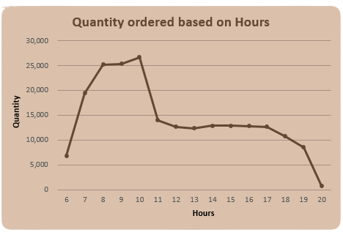
Sales Trend by Hour of the Day
Key Findings
Sales volume peaks between 7 AM and 10 AM
The highest quantity ordered occurs around 9–10 AM
Sales decline significantly after 11 AM and remain flat through the afternoon
Minimal activity after 7 PM
Business Interpretation
The coffee shop is highly dependent on morning demand, suggesting commuter-driven purchasing behavior.
Recommendation
Increase staffing and inventory during morning peak hours
Introduce afternoon promotions to improve off-peak utilization

Slide 5
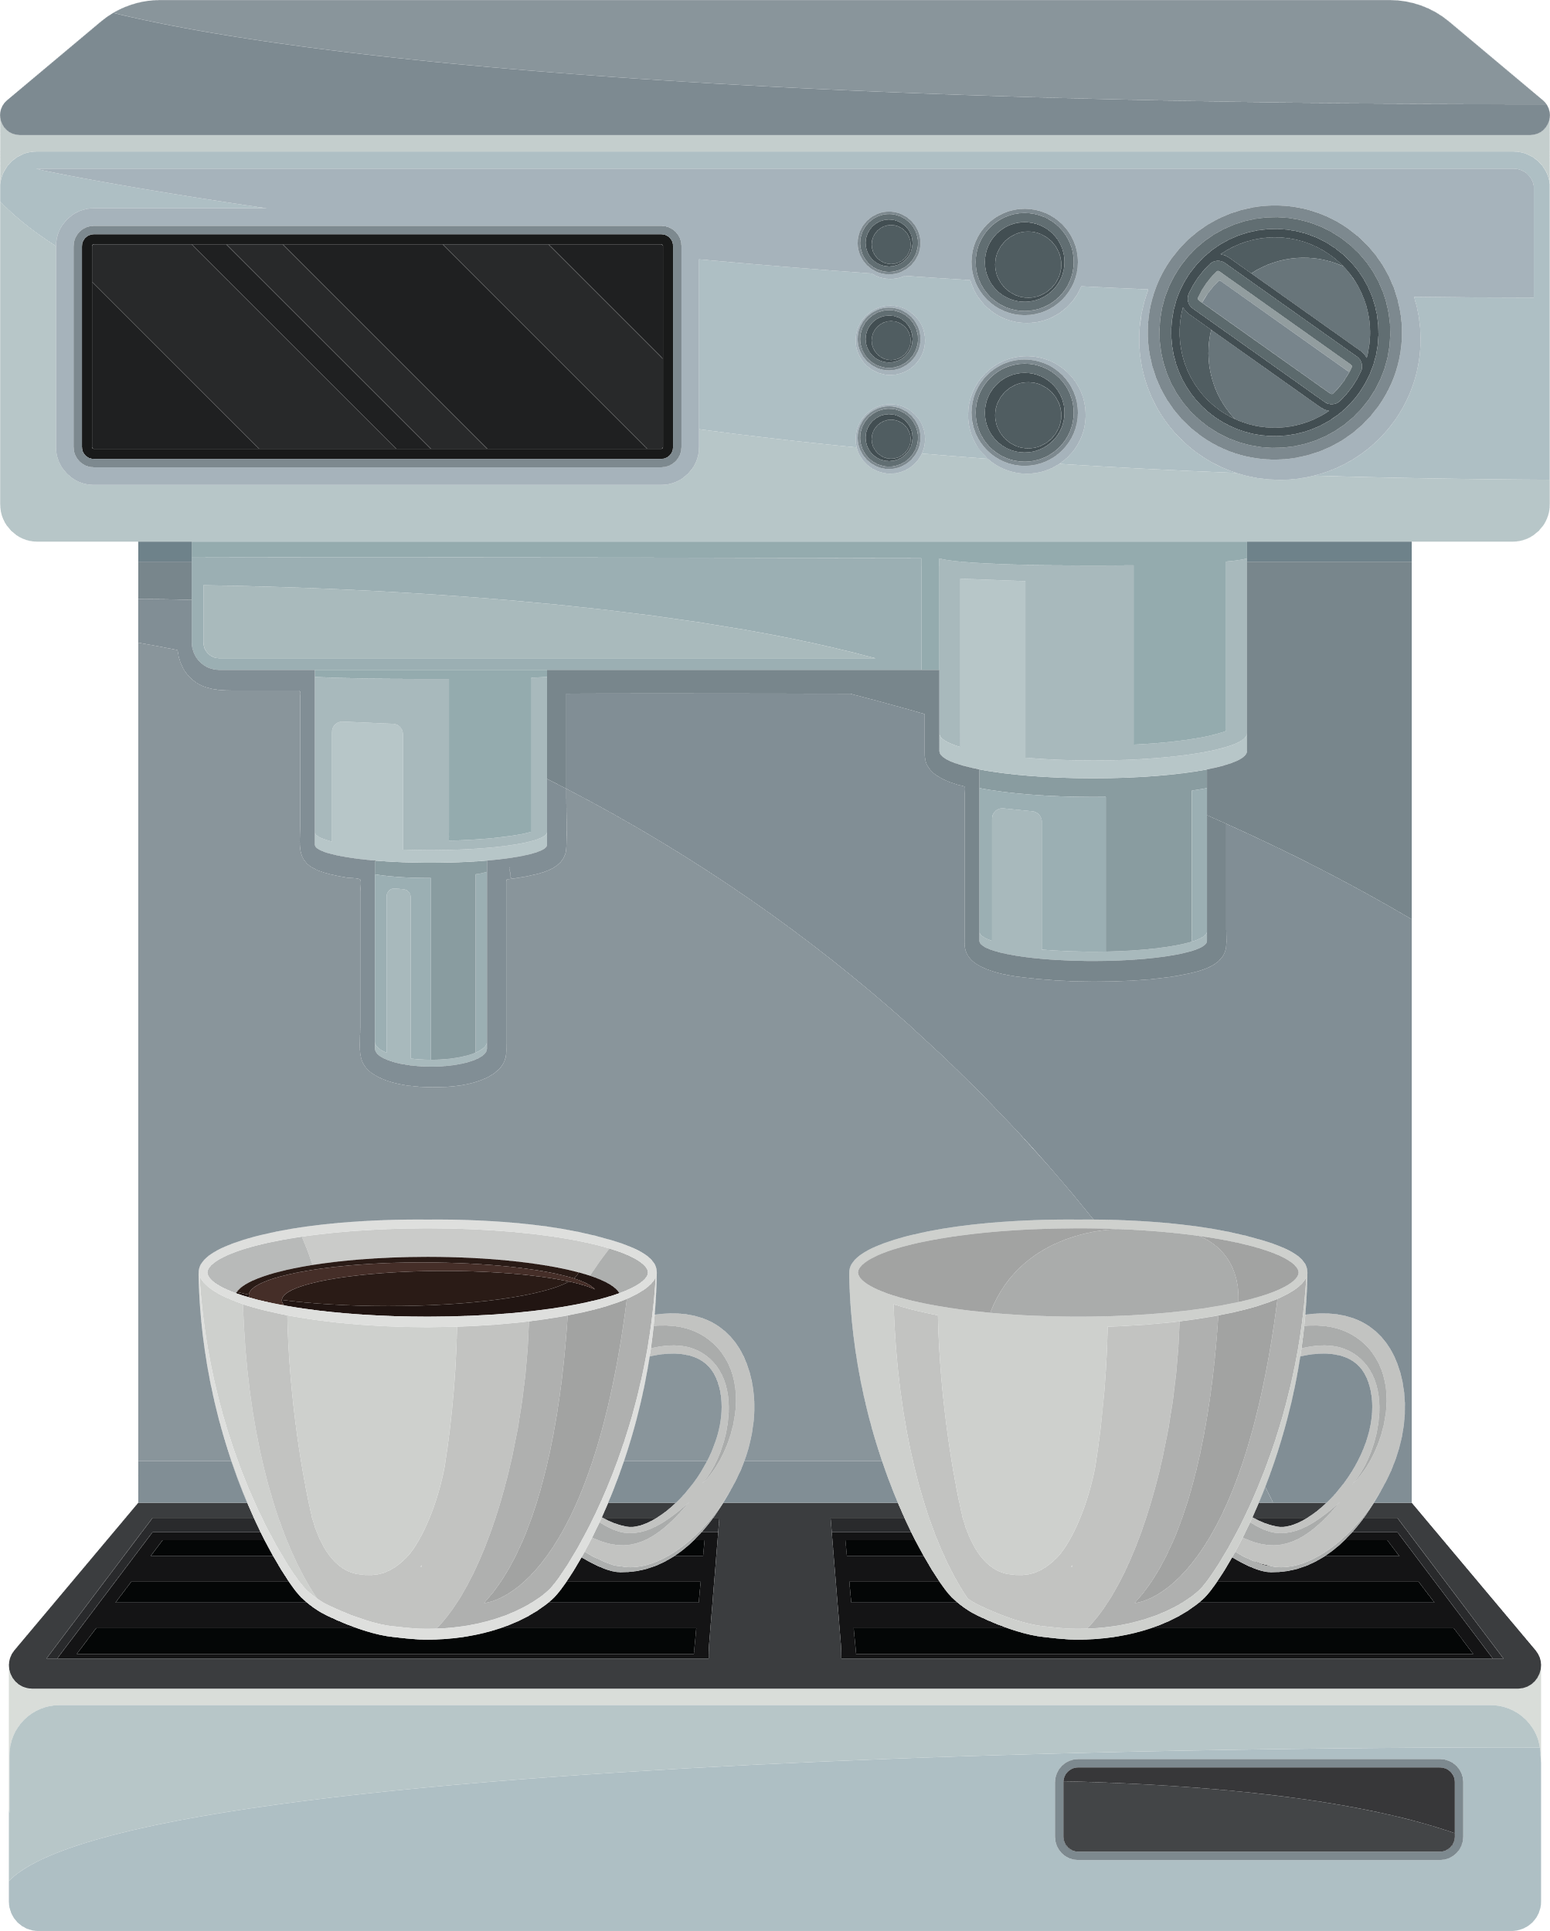
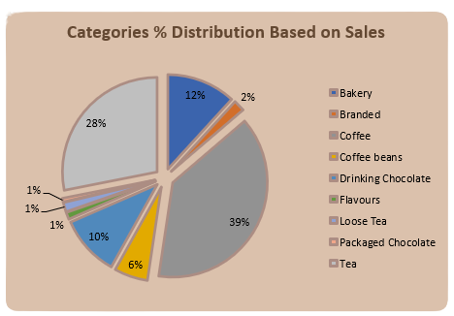

SALES DISTRIBUTION BY PRODUCT CATEGORY
Category Contribution to Total Sales
Coffee: ~39%
Tea: ~28%
Bakery: ~12%
Remaining categories contribute marginally
Insight
Coffee and Tea together account for over two-thirds of total revenue, confirming that the business is driven by core beverage products rather than ancillary items.
Recommendation
Protect core beverage quality and pricing
Use bakery and add-ons as complementary upsell products

Slide 6
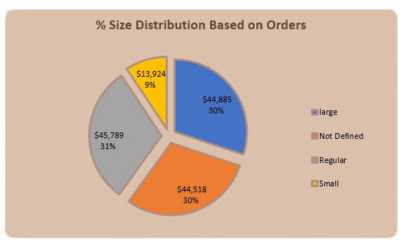


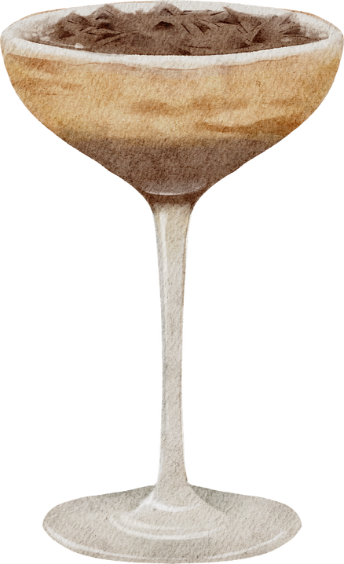


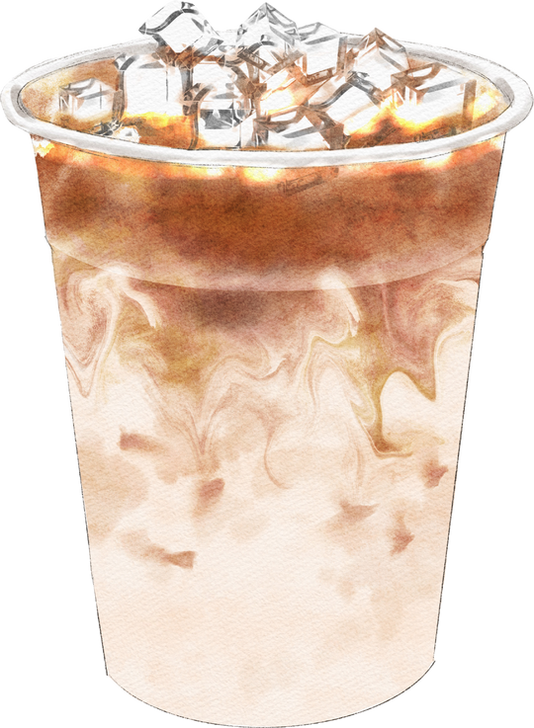




Order Size Distribution
Order Size Breakdown
Regular: 31%
Large: 30%
Not Defined: 30%
Small: 9%
Insight
Most customers opt for regular or large sizes, indicating comfort with mid-to-high pricing tiers.
Recommendation
Promote size upgrades through minimal price differences
Clearly define “Not Defined” orders to improve data quality

Slide 7
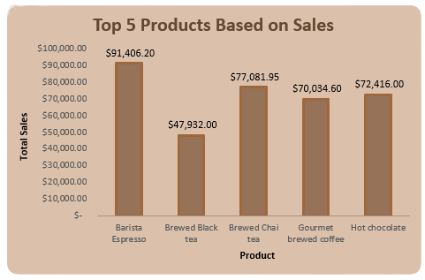

Best-Selling Products Analysis
Top Products by Sales Revenue
Barista Espresso: $91,406.20
Brewed Chai Tea: $77,081.95
Hot Chocolate: $72,416.00
Gourmet Brewed Coffee: $70,034.60
Brewed Black Tea: $47,932.00
Insight
Classic beverages dominate sales, indicating strong customer preference for familiar, reliable products.
Recommendation
Maintain consistent quality for top sellers
Introduce premium variations of best-performing items

Slide 8
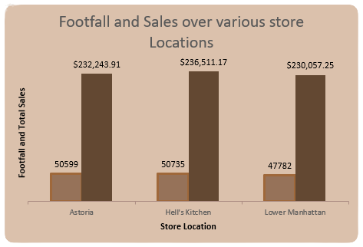

STORE LOCATION PERFORMANCE
Sales & Footfall by Location
Hell’s Kitchen: $236,511.17 (Highest)
Astoria: $232,243.91
Lower Manhattan: $230,057.25 (Lowest)
Footfall Insight
Despite relatively less footfall in lower Manhattan, revenue is similar to other locations, suggesting differences in order value or product mix.
Recommendation
Analyze product-level performance by location to replicate high-revenue strategies across all stores.

Slide 9
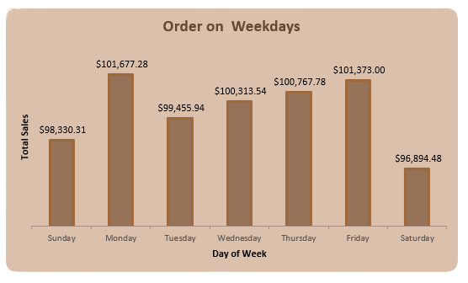
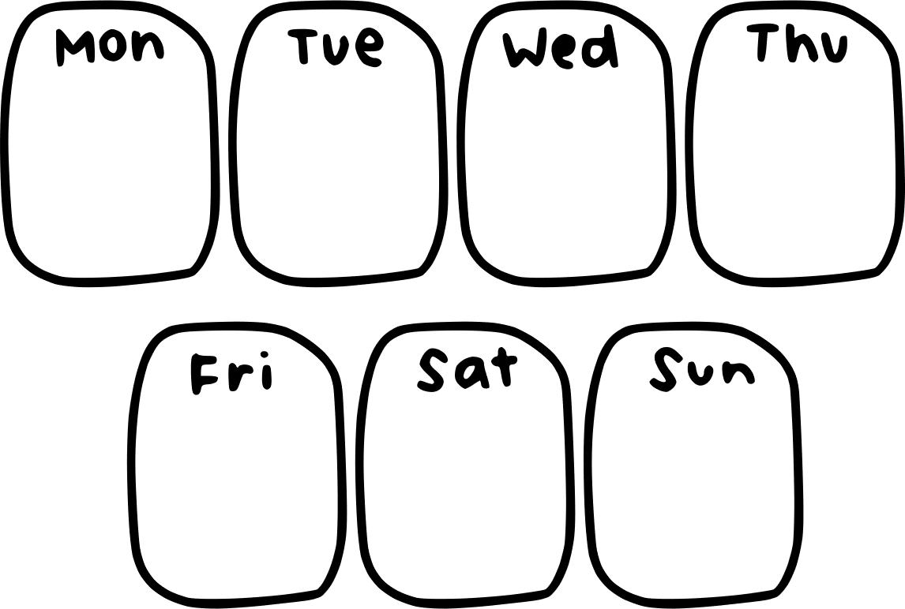
Sales by Day of the Week
Weekly Sales Pattern
Highest sales on Monday and Friday
Lowest sales on Saturday
Stable performance during midweek
Interpretation
Weekday sales outperform weekends, reinforcing the workday coffee consumption model.
Recommendation
Launch weekend-specific promotions
Target leisure customers with bundled offers on Saturdays

Slide 10

Business Insights Summary
Key Insights
Morning hours drive the majority of revenue
Coffee and tea dominate category performance
Average spend per customer is low but scalable
Location performance is consistent but optimizable
Product mix favors classic beverages

Slide 11


STRATEGIC RECOMMENDATIONS
Optimize staffing and inventory during morning peak hours
Introduce off-peak and weekend promotions
Upsell size upgrades and bundled products
Expand premium variants of top-selling beverages
Improve data definitions to enhance reporting accuracy

Slide 12
THANK YOU

